Slide 1

Data Analysis Final Project – survey data analysis
Filip Jovanović
19.12.2024.

Slide 2



OUTLINE
Executive Summary
Introduction
Methodology
Results
Visualization – Charts
Dashboard
Discussion
Findings & Implications
Conclusion
Appendix

Slide 3

EXECUTIVE SUMMARY
Data extraction
Data manipulation
Data cleaning
Removing duplicates and handling missing values
Exploratory data analysis
Visual data analysis
Deriving insights
Seeing trends

Slide 4

INTRODUCTION
This project and presentation was made to take a closer look into developer work experience and technologies used
Point of this presentation is to show trends and insights that would guide new developer in a desired direction
Large dataset was used to derive insights and make conclusions that cover a big portion of the industry standard
To come to these conclusions 2 things had to be done:
Data needed to be collected, extracted and transformed
Data needed to be examined and interpreted in a meaningful way so it clearly presents findings

Slide 5

METHODOLOGY
Language used: Python
Data extraction tools: web scarping tools, API-s and bash commands
Data loading tools: pandas, sqlite3 to load data into a table
Data visualization tools
Matplotlib
Seaborn

Slide 6
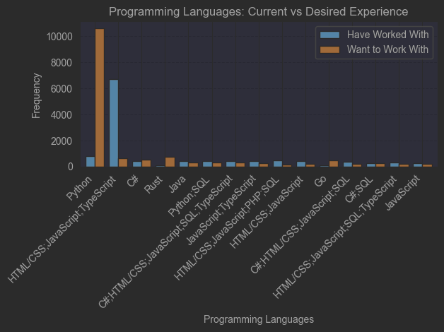
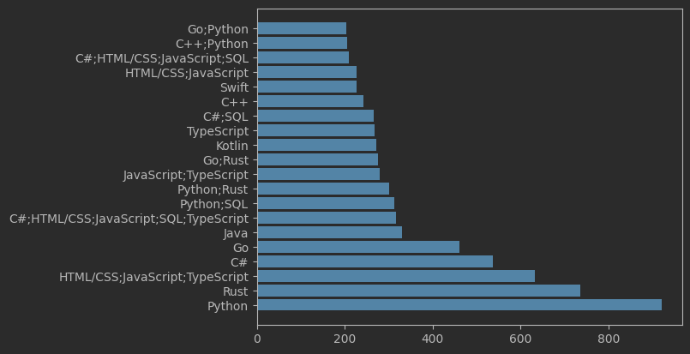
PROGRAMMING LANGUAGE TRENDS
Current Year
Next Year
<Bar chart of top 10 programming languages for the current year goes here.>
< Bar chart of top 10 programming languages for the next year goes here.>

Slide 7
PROGRAMMING LANGUAGE TRENDS - FINDINGS & IMPLICATIONS
Findings
Python is taking a big shift towards being one of the most used languages
Typescript is rapidly gaining popularity
Most other languages are retaining their popularity
Implications
People are following the trends, the more language is used the more people will choose to use it
High level languages are seeing a steep rise in usage
Shift in technologies is good and it can be clearly seen in charts from last slide

Slide 8
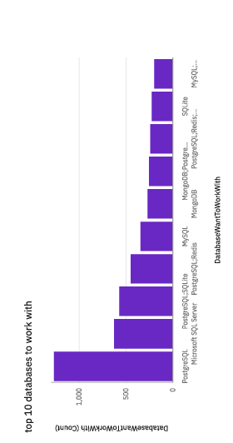
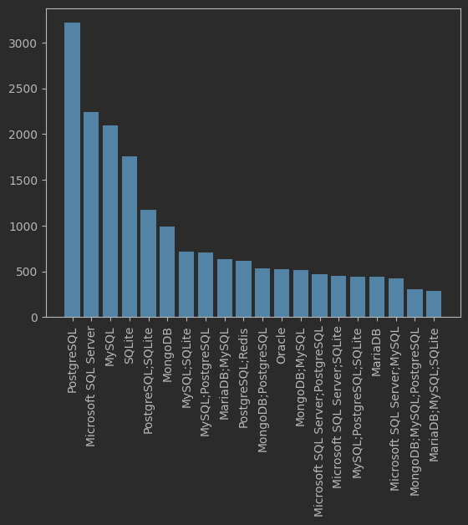
DATABASE TRENDS
Current Year
Next Year
< Bar chart of top 10 databases for the current year goes here >
< Bar chart of top 10 databases for the next year goes here.>

Slide 9
DATABASE TRENDS - FINDINGS & IMPLICATIONS
Findings
Database trends for the current and upcoming year did not change drastically
People tend to stick to the databases they work with
Change in databases for the next year is noticeable in a sense that some databases switched place in the top 10/20 ranking but no new ones entered
Implications
People have database preferences and when learned it can be hard to transfer to another DB system
Changing the database that you work with could most likely mean that you changed jobs or a position
To switch to a new database can mean that change for a developer occurred in the whole tech stack

Slide 10
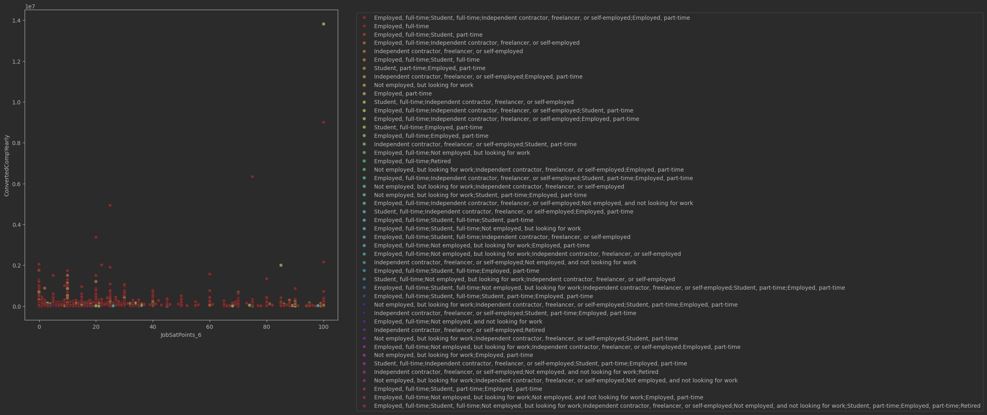
Scatter plot of Eployment (skills), Yearly compensation and Job satisfaction

Slide 11

DASHBOARD
Next couple of slides will focus on current and upcoming technology trends and demographics

Slide 12
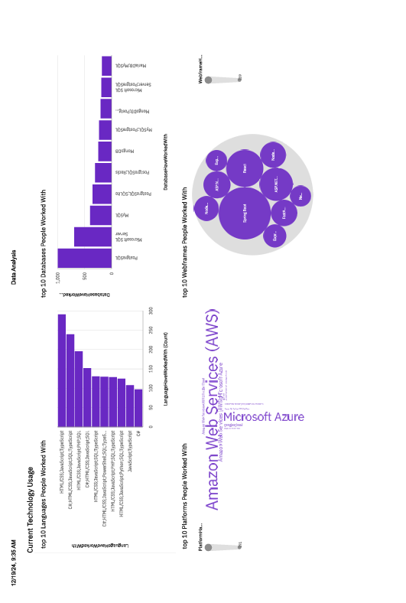
Current technology usage

Slide 13
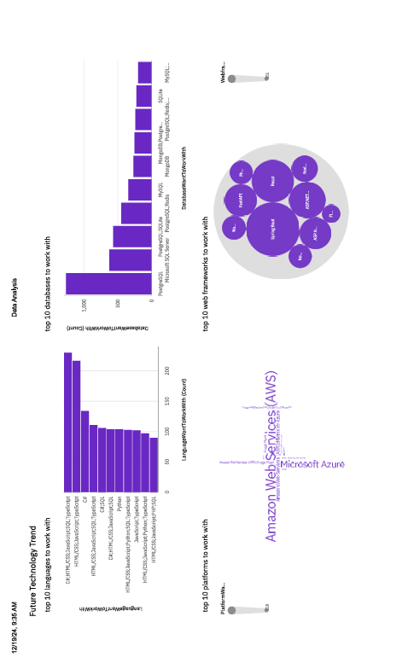
Future technology trends
Screenshot of dashboard tab 2 goes here

Slide 14
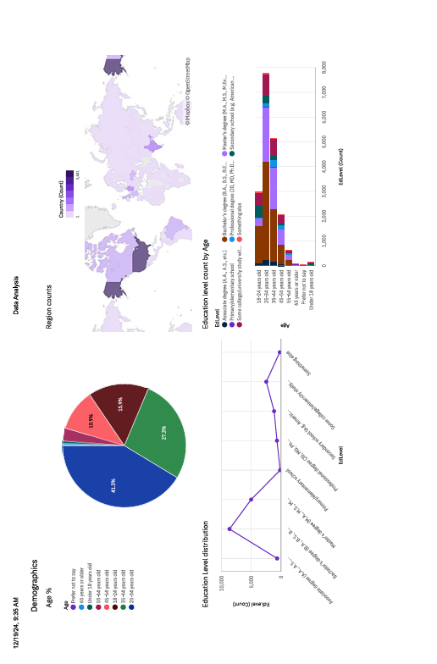
Demographics
Screenshot of dashboard tab 3 goes here

Slide 15
Insights From Dashboards
Findings
Trends from current technologies point out that a significant part of developers and projects are focused on web development
Future technology trends show us the rise of data driven solutions along with existing web frameworks
We can see that mostly young people with some kind of education (Masters/Bachelor’s) from USA, Europe and India are currently in development department
Implications
Web 2 is popular and has been popular for quite some time to make a solid foundation for upcoming tech stacks
Web 3, Big Data, ML and AI have a steep rise and will continue to gain popularity due to need of decentralization, data driven solutions and automatization
Although USA, Europe and India provide a great amount of developers, the slow rise of other parts of the world could prove to be a great benefit to the industry

Slide 16
Overall Findings and Implications
Findings
Future trends show a promising path towards better web, data driven projects, AI rise, and automatization
Past trends show what carved the path towards more modern world
Job satisfaction and earnings in this everchanging industry correlate greatly with years of work experience and tech of age in question
Implications
We should keep up with the trends and try to stay in motion and keep our step with all new and more complicated demands
New technologies must not always mean better products and better results and tools, it is better to stick to known tech stack when there is a potential problem whit something fresh
Job satisfaction and pays are highly variable fields and should regularly be examined

Slide 17

CONCLUSION
Tech changes but slowly and over time and not over night some people think
New technologies are good but not always the best solution
Job preferences and satisfaction and experience are highly correlated matters and for the benefit of employees they should be more frequently studied and taken into a count

Slide 18

APPENDIX
GitHub repo for the whole source code and project along with this pptx:
https://github.com/File500/Data_analysis_Final.git

Slide 19
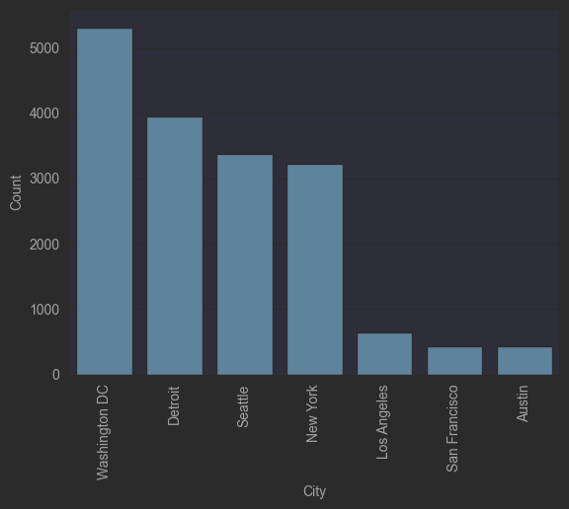
JOB POSTINGS

Slide 20
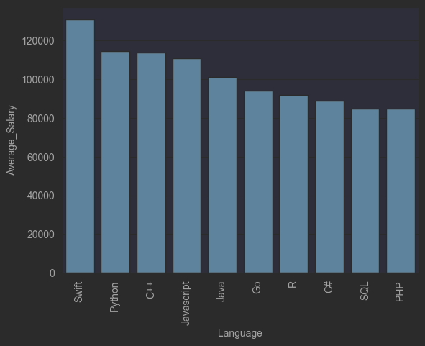
POPULAR LANGUAGES

